Slide 1
mdtmFTP and Its Evaluation on ESNET SDN Testbed
Funded by DOE/SC/ASCR Network Research Program

Slide 2
Big data transfer challenges

Slide 3
Data transfer – state of the art
Advanced data transfer tools and services developed
GridFTP, BBCP
PhEDEx, LIGO Data Replicator, Globus Online
Numerous enhancements
Parallelism at all levels
Multi-stream parallelism
Multicore parallelism
Multi-path parallelism
Science DMZ architecture
Terabit networks

Slide 4
Problems with existing data transfer tools
Unable to fully exploit multicore hardware under default OS support, especially on NUMA systems
Unable to effectively address the lots of small files (LOSF) problem
Either inefficient, or don’t scale well:
Pipelining
Concurrency
Tar-based solution

Slide 5
mdtmFTP: a high-performance data transfer tool
Pipelined I/O-centric design to streamline data transfer
Multicore-aware data transfer middleware (MDTM) optimizes use of underlying multicore system
Extremely efficient in transferring of Lots Of Small Files
Various optimization mechanisms
Zero copy
Asynchronous I/O
Batch processing
A DOE/SC/ASCR-sponsored research project
Software is available at: http://mdtm.fnal.gov

Slide 6
A pipelined I/O centric design - 1
Dedicated I/O threads to perform network & disk I/O operations in parallel
MDTM middleware to schedule cores for I/O threads
Each I/O thread pinned to a core near the I/O device the thread uses
I/O locality
Core affinity for I/O operations
An I/O thread is typically dedicated with a single core
System zoning to avoid interference with other applications
MDTM-zone for mdtmFTP
Non-MDTM-zone for other applications

Slide 7
A pipelined I/O centric design - 2
Advanced data buffer mechanism to improve I/O performance
Pre-allocated data buffers to avoid costly memory allocation/deallocation in the critical I/O path of data transfer
Data buffers are pinned and locked to avoid memory swap and migration

Slide 8
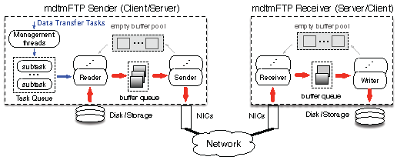
A pipelined I/O centric design - 3
Data transfers are executed in a pipelined manner
A data transfer task is split into multiple subtasks
Subtasks are executed in parallel

Slide 9
MDTM middleware – why?
Default OSes cannot support data transfer tools on multicore systems well, especially NUMA systems:
Dynamic load balancing may degrade data transfer performance
Frequent thread migration
No core affinity for I/O operations
Inefficient use of cache
High-latency inter-node communication
Limited support for I/O locality
I/O throughputs can be significantly improved if I/O locality is available
Other applications’ interferences
CPU, MEM, I/O

Slide 10
What is MDTM middleware?
A user-space resource scheduler
Implemented as a system daemon
Periodically, collects, monitors, and caches information about the multicore system
Physical layout (e.g., NUMA topology)
Configurations
System loads
Upon requests, provide middleware services to mdtmFTP
Query service
Scheduling service

Slide 11
MDTM middleware – key features
Key Features
Computer system layout profiling
Real-time system status monitoring
CPU usage of each core
Memory load latency of each NUMA node
NUMA topology-based core scheduling
Support I/O locality
Support core affinity on I/Os
System zoning
MDTM Zone and Non-MDTM zone
Data buffer allocation and pinning capability
MDTM middleware can be readily extended to support other types of applications
E.g., as a research tool to study advanced scheduling algorithms and policies on NUMA systems

Slide 12
A large virtual file mechanism to address the LOSF problem
Key idea:
Treat a dataset as a large “virtual file”.
Each file in the dataset is treated as a file segment in the virtual file, and sequentially “added” to the virtual file.
The virtual file is logically, instead of physically, created.
Different than Tar-based solutions
The whole data set is transferred, continuously & seamlessly, as a single virtual file.
Different than GridFTP’s per-file-based mechanisms (e.g., pipelining, concurrency)
Major advantages:
Avoid protocol processing on a per-file basis
Allow for batch processing small files in the sender/receiver to optimize I/O performance

Slide 13
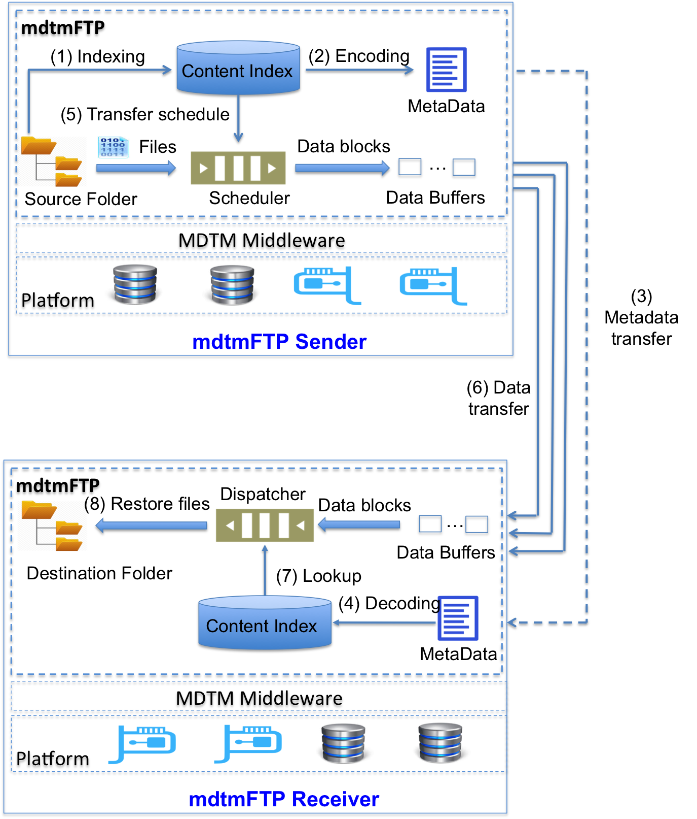
Large virtual file transfer mechanism

Slide 14
mdtmFTP evaluation @ ESnet testbed
Test and evaluate mdtmFTP at WAN environment
Test and evaluate mdtmFTP at high-performance DTN environment
Compare mdtmFTP with other data transfer tools

Slide 15
ESNET testbed - 1
nersc-tbn-1
2xIntel HaswellXeon E5-2643 6 cores
Motherboard: superMicro X10DRi (PCIe Gen3)
2x40G Mellanox NICs
Support high performance I/O operation (Write)
An array of 24 HDDs
nersc-tbn-2
2xIntel HaswellXeon E5-2643 6 cores
Motherboard: superMicro X10DRi (PCIe Gen3)
2x40G Mellanox NICs
Support high performance I/O operation (Read)
An array of 12 SSDs
Data transfer:
DTN “nersc-tbn-2” → “nersc-tbn-1”.
95ms RTT loop between nersc-tbn-1 and nersc-tbn-2.
Note: Thanks to ESNET Brian Tierney and Eric Pouyoul

Slide 16
Evaluation methodology - 1
Transfer data from nersc-tbn-2 to nersc-tbn-1
Performance metric: Time-to-Completion
Data transfer tool
mdtmFTP (developed by FNAL)
http://mdtm.fnal.gov
FDT (developed by CalTech)
http://monalisa.cern.ch/FDT/
BBCP (developed by SLAC)
https://www.slac.stanford.edu/~abh/bbcp/
GridFTP (developed by University of Chicago)
http://toolkit.globus.org/toolkit/docs/latest-stable/gridftp/

Slide 17
Evaluation methodology - 2
Transfer Mode
Client-Server data transfer
3rd-Party data transfer
Data Transfer Scenarios:
Large file transfer: Transferring a 100GB large file from nersc-tbn-2 to nersc-tbn-1.
Folder transfer 1: Transferring a folder that has 30 10G files from nersc-tbn-2 to nersc-tbn-1
Folder transfer 2: Transferring a Linux-3.18.21 folder from nersc-tbn-2 to nersc-tbn-1

Slide 18
Evaluation Methodology - 3
Data transfer tool configuration
Data Transfer tools | # of Parallel Streams | Pipelining | Currency | TCP parameters
FDT | 4 | N/A | N/A | System configuration
GridFTP | 4 | -PP | -CC 8 | System configuration
BBCP | 4 | N/A | N/A | System configuration
mdtmFTP | 4 | N/A | 2 I/O threads | System configuration
Note: when # of parallel streams > 4, data transfer performance has negligible changes

Slide 19
Result – Client/Server
 | mdtmFTP | FDT | GridFTP | BBCP
Time-to-Completion (seconds) | 74.18 | 79.89 | 91.18 | Poor performance
Larger file data transfer – 1 x 100G (Smaller is better)
 | mdtmFTP | FDT | GridFTP | BBCP
Time-to-Completion (seconds) | 192.19 | 217 | 320.17 | Poor performance
Folder data transfer – 30 x 10G (Smaller is better)
 | mdtmFTP | FDT | GridFTP | BBCP
Time-to-Completion (seconds) | 10.51 | - | 1006.02 | Poor performance
Folder data transfer – Linux 3.12.21 (Smaller is better)
Note 1: “-” indicates inability to get transfer to work
Note 2: BBCP performance is very poor, we do not list its results here

Slide 20
Result – Client/Server
Large File Data Transfer (1x100G)
Folder Data Transfer (30x10G)
Folder Data Transfer (Linux 3.12.21)
GridFTP’s Time-to-Completion
Relative performance improvement (base: GridFTP) =
other tools’ Time-to-Completion
Note: Larger is better

Slide 21
Result – 3rd party data transfer
 | mdtmFTP | FDT | GridFTP | BBCP
Time-to-Completion (seconds) | 34.976 | N/A | 106.84 | N/A
Larger file data transfer – 1 x 100G (Smaller is better)
 | mdtmFTP | FDT | GridFTP | BBCP
Time-to-Completion (seconds) | 95.61 | N/A | - | N/A
Folder data transfer – 30 x 10G (Smaller is better)
 | mdtmFTP | FDT | GridFTP | BBCP
Time-to-Completion (seconds) | 9.68 | N/A | - | N/A
Folder data transfer – Linux 3.12.21 (Smaller is better)
Note 1: “-” indicates inability to get transfer to work
Note 2: : BBCP and FDT support 3rd party data transfer. But BBCP and FDT
Couldn’t run 3rd party data transfer on ESNET testbed due to testbed limitation

Slide 22
Result – 3rd party data transfer
Large File Data Transfer (1x100G)
GridFTP’s Time-to-Completion
Relative performance improvement (base: GridFTP) =
other tools’ Time-to-Completion
Note: Larger is better

Slide 23
Summary
mdtmFTP is a high-performance data transfer tool
Pipelined I/O-centric design to streamline data transfer
Multicore-aware data transfer middleware (MDTM) optimizes use of underlying multicore system
Extremely efficient in transferring of Lots Of Small Files
Evaluations show that mdtmFTP can achieve higher performance than existing data transfer tools.

Slide 24
Acknowledgement
We would like to thank Brian Tienery who contributed to mdtmFTP evaluation @ ESnet testbed

